Slide 1
Testing and Mitigation, COVID-19 SHIP Grant technical assistance webinar Montana Office of Rural Health and MSU office of Sponsored Programs
July 28 and 30, 2021

Slide 2
Welcome
Agenda
Welcome and introductions: MT Office of Rural Health, MSU Office of Sponsored Programs
Testing and Mitigation, COVID-19 SHIP grant processes
Timeframe
Subawards
Disbursement of funds
Allowable expenditures
Reporting requirements
Office of Sponsored Programs—specific details
Equipment expenditures
Alteration and renovation
Documentation—best practices for submission and reimbursement

Slide 3
Testing and Mitigation SHIP COVID, Program Overview
One-time funding to support hospitals increase COVID-19 testing and expand the range of mitigation efforts.
Funding may not be used for any activity related to vaccine purchase or distribution.
Testing: Increase testing efforts, expand access to testing
Mitigation: keeping hospital staff and patients safe
Mitigation: investigation and contact tracing to reduce spread
Funded through HRSA, Federal Office of Rural Health Policy

Slide 5
Timeframe SUbawards
July 1, 2021 through December 31, 2022
Hospital costs can be dated back to January 1, 2021 for reimbursement
Issued from MSU Office of Sponsored Programs.
Subaward agreement documents the period of performance, the authorized amount, and terms and conditions for the subrecipient.
Award amount is $224,675 per hospital.
Upon receipt of signed subaward agreement, 50% of the funding will be disbursed (in the amount of $112,337.50).

Slide 6
Testing and Mitigation COVID 19 SHIP funds
Total grant amount per hospital is $224,675. All participating SHIP hospitals were funded at the same level.
Upon receipt of signed subaward agreement, 50% of the funding will be disbursed immediately (in the amount of $112,337.50).
The remaining balance of $112,337.50 can be released upon receipt of invoices documenting related expenditures (up to the total amount of $224,675) and required reporting as outlined by HRSA.
Some hospitals have declined this round of funding. If you wish to decline funding at this point, please contact Cindra. Additionally, you are not obligated to utilize 100% of funds—balance will be returned to HRSA.
If unspent funds include amounts already paid to the hospital with execution of the award, those funds must be returned to MSU.
MSU OSP is aware that completion of large projects may be a financial hardship for hospitals while waiting for reimbursement. Therefore, they will reimburse incrementally when requested, with the receipt of appropriate documentation.
If a large equipment or A/R purchase is anticipated, please contact Cindra in advance for further clarification.

Slide 7
Allowable expenditures
The hospital must demonstrate that the related expense is directly and reasonably related to the provision of COVID-19 testing or COVID-19 mitigation activities. The related expense must be appropriate give relevant clinical and public health guidance. For additional examples, please visit CDC Community Mitigation Framework website. (https://www.cdc.gov/coronavirus/2019-ncov/community/community-mitigation.html)
Funding may not be used for any activity related to vaccine purchase or distribution, but could be used for community vaccine education activities.
Examples of allowable activities and expenditures have been shared with you previously. We will also post to the Office of Rural Health/AHEC website. Call Cindra with any questions.

Slide 8
Reporting
Details are still being determined at the Federal level.
Be prepared to document number of tests per quarter. Cindra will report this information (on your behalf). Details to come.
Reporting details for equipment (SF428S):
Award Number | GP or ACQ | Description of the item | Identification Number | Acquired Date | Condition Code | Acquisition Cost | Disposition Request

Slide 9
Special considerations for Equipment purchases
Equipment is tangible personal property and includes information technology systems
Per-unit acquisition cost of at least $5000
Moveable equipment only
MUST be procured through a competitive process. Keep proof of comparison cost-checking.
Equipment must be maintained, tracked and disposed of per 45 CFR 75.
Tangible personal property report

Slide 10
Minor Alterations and Renovations (A/R)
Supports improvements, conversion, rehabilitation, remodeling, or modernization
Distinguished from construction and large-scale permanent improvements
No cap on A/R costs for this grant—if costs exceed 50% of hospital award, Project Officer approval is required
Quarterly reporting by grantee if hospitals allocate funds to A/R
Required documentation
Project implementation certification and itemized budget for minor A/R
Project completion Certification for minor A/R

Slide 11
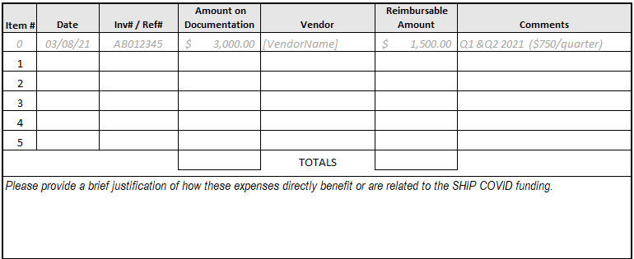
INVOICE TEMPLATE

Slide 12
Supporting Documentation
Examples of Supporting documentation include (but are not limited to):
Invoices (vendor, item description, date and amount paid);
Itemized Receipt (confirmation of payment);
Purchase dates should fall within grant period;
Connection to the grant (cost center, fund type code) – in general ledger;
Contracts for services (signed and dated);
Detailed travel logs if claiming travel expense.

Slide 13
Funds will be returned to HRSA
If your hospital has received the advanced payment and does not fully expend it, the unspent funds must be returned to MSU.
Furthermore, if you determine you cannot use all or part of your total award amount, or if you decide to decline participation completely, those funds will be returned to HRSA.
In either scenario, you should contact Cindra and OSP as soon as possible.

Slide 14
Please feel free to get in touch…
Cindra Stahl, Montana Office of Rural Health
cindra.stahl@montana.edu
406-994-6499
Http://healthinfo.montana.edu/morh/ship/index.html
For questions regarding the status of your subaward agreement or for invoicing preparation questions:
Jennifer Nesbitt or Mercy Boys, Office of Sponsored Programs
subawards@montana.edu
406-994-2381
For questions regarding equipment and alteration/renovation:
Tracy Gatlin, Office of Sponsored Programs tracy.gatlin@montana.edu
406-994-2381

