Slide 1
Rural Health Clinic Updates from Washington, D.C.
Sarah Hohman, MPH, CRHCP
Director of Government Affairs
National Association of Rural Health Clinics

Slide 2
H-1B Visa Policy Latest Updates
Trump Administration created a $100k fee for H-1B visas, vastly limiting the facilities and providers that could utilize this tool
$100k fee was blocked by a judge, claiming an unlawful tax that required Congressional approval
Bipartisan House members introduced the H–1Bs for Physicians and the Healthcare Workforce Act (H.R.7961)
  Would exempt health care workers from the $100,000 fee
This week, DHS reissued a proposal for a $103,265 fee to “support immigration programs that otherwise must be funded by taxpayers”

Slide 3
FY2027 Government Funding
The federal government’s fiscal year will end September 30, 2026
  House and Senate have passed different versions of FY27 continuing resolutions, need to reconcile
Without appropriations funding for FY27, they could shut down
  Not politically appetizing before an election!
House on recess through August 31, Senate through September 14

Slide 4
Montana Implementation - Medicaid Work Requirements
Montana work requirements began July 1, 2026
  State resources: https://dphhs.mt.gov/medicaidchanges/
How have your RHCs been involved? Are patients asking more questions? Are you monitoring payor fluctuations more frequently?

Slide 5
Rural Health Transformation Program (RHTP)
Montana received $233 million in 2026
  General information: https://dphhs.mt.gov/RuralHealthTransformationProgram/
No current funding opportunities open, but a Request for Information regarding Health Care Provider Mental Health and Workplace Wellness
  RFI closes August 31: https://dphhs.mt.gov/RuralHealthTransformationProgram/RHTP-RFPs

Slide 6
CMS Announces Plans for RHC Self-Attestation Process
CMS plans to implement a program through which RHCs would be required to complete a brief, self-attestation form every 6 years, in lieu of periodic on-site surveys
NARHC staff have sent comments to CMS
  We acknowledge the intent of CMS to reduce administrative burdens placed on RHCs
  Recommend focusing on fixing the underlying regulations and policies causing the administrative burdens in the first place instead of changing the method in which RHCs demonstrate program compliance
  Currently awaiting more information (effective date, etc.)

Slide 7
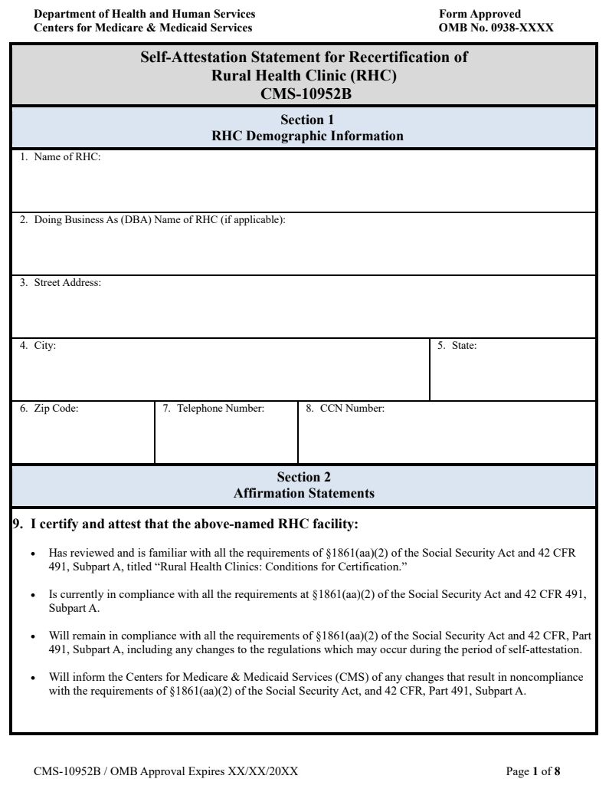
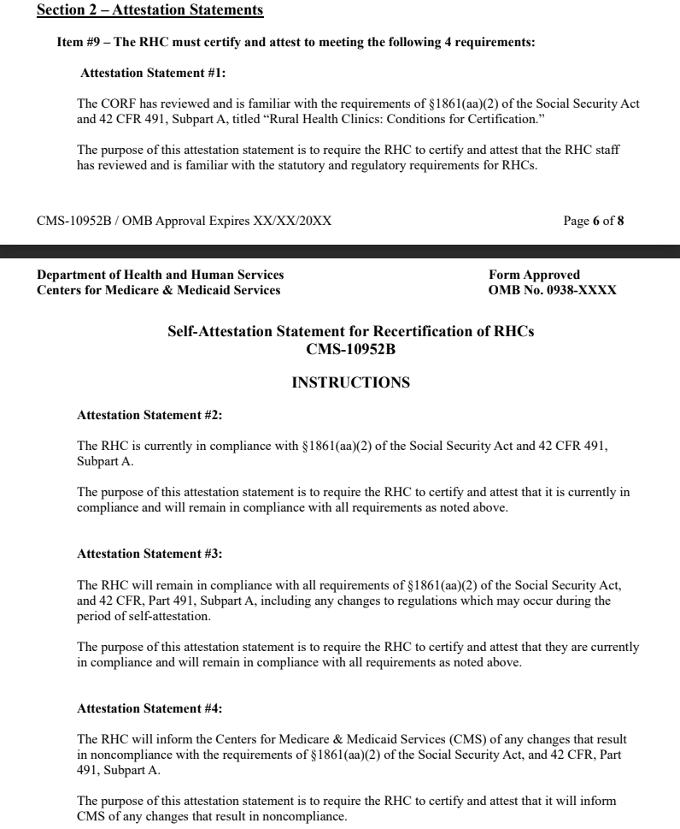

Slide 8
MPFS 2027 Proposals
Diabetes Self-Management Training (DSMT) and Medical Nutrition Therapy (MNT)
Beginning January 1, 2027, DSMT and MNT services will be considered as qualified preventive services that are covered and paid the All-Inclusive Rate as stand-alone billable visits under the RHC benefit
Dieticians and other nutrition professionals, under the direct supervision of a qualified RHC provider, would be permitted to furnish these services. If performed on the same day as another medical visit, the RHC would only be paid one AIR payment.
  The supervising practitioner must be present in the RHC and immediately available to provide assistance/direction
Deductible and co-insurance will likely apply, but we will clarify with CMS. Additionally, we will inquire as to whether RHC limitations on group visits apply to these services.

Slide 9
What is Diabetes Self-Management Training and Medical Nutrition Therapy?
Diabetes Self-Management Training (DSMT) is an evidence-based educational program for people with type 1, type 2, and gestational diabetes.
  DSMT provides newly diagnosed patients with 10 hours of initial diabetes training in the first year of their diagnosis.
  This program is then followed by two hours annually to help people manage their diabetes self-care behaviors
Medical Nutrition Therapy (MNT) is a nutrition-based medical service that qualified professionals provide to treat and manage chronic kidney diseases, diabetes, and prediabetes.
  MNT uses individualized nutrition interventions delivered as part of a care plan in coordination with other health professionals.
  MNT can also include nutrition assessment/reassessment, nutrition diagnosis, and nutrition monitoring and evaluation.

Slide 10
Who can provide Diabetes Self-Management Training and Medical Nutrition Therapy?
Provider/team that meets National Standards for Diabetes Self-Management Education and Support (DSMES) and is accredited through a CMS-certified accredited organization
Team members may include registered dietitians, nutrition professionals, registered nurses, pharmacists, and other professionals trained in diabetes care and education
Provider Information on DSMT from CMS (not RHC specific)

Slide 11
What Was NOT Proposed for RHCs
CMS did not extend several new billing opportunities created for fee-for-service providers to RHCs, including:
  Shared Medical Appointments
  Health Coaching
NARHC will be commenting how this is out of alignment with Make America Healthy Again (MAHA) priorities
CMS also did not:
  Amend the definition of an RHC medical visit to allow for Annual Wellness Visits (other than IPPEs) to be eligible for same day billing
  Allow for those AWVs to be completed by RNs, as they are in non-RHC settings
  Change the limitation on group visits in the RHC setting

Slide 12

Make Your Voice Heard!
Show support for or ask for modifications to various CMS proposals in the 2027 Medicare Physician Fee Schedule!

Slide 13

Telehealth Policy
Current Medicare medical telehealth flexibilities will expire on December 31, 2027 without Congressional action
CMS recently announced that beginning October 2026, RHCs will no longer bill G2025 for medical telehealth, and instead bill the individual HCPCS codes for services performed via this modality
  Does not change payment, just coding
  Modifiers: 93 for audio-only, 95 for audio-visual telehealth

Slide 14
Remote Physiologic Monitoring (RPM) / Remote Therapeutic Monitoring (RTM)
Care management services – collection, analysis and interpretation of digitally collected data
  Glucometer, blood pressure monitor, digital scale, etc.
Office of the Inspector General (OIG) report found:
  The use of remote patient monitoring in Medicare increased dramatically from 2019 to 2022.
  About 43 percent of enrollees who received remote patient monitoring did not receive all 3 components of it, raising questions about whether the monitoring is being used as intended.
  OIG and CMS have raised concerns about fraud related to remote patient monitoring.
  Medicare lacks key information for oversight, including who ordered the monitoring for the enrollee.

Slide 15
RPM/RTM Proposed Changes CY2027
Requiring that RTM services are only furnished to established patients
Requiring an initiating visit for RPM/RTM services
  Provider assesses need for RPM/RTM
  Discusses RTM/RPM with patient

Slide 16
RPM/RTM Proposed Changes CY2027
"We do not believe that RPM or RTM services provided by clinical staff contracted by a third party can ensure the billing practitioner has adequate oversight, management, or collaboration to bill RPM or RTM services." - CMS
Proposes to only allow payment for RPM/RTM when furnished by clinical staff employed by the practice

Slide 17
Artificial Intelligence in Primary Care
CMS acknowledges that clinical artificial intelligence is becoming more widespread and has the potential to reduce administrative burden and provide clinical decision-support, however they are seeking more detailed information on its usage in order to determine how to approach payment for such tools and services.
Sample Questions:
  If you are a provide furnishing primary care services, how has your practice been impacted or how do you expect it will be impacted by clinical AI tools?
  If these tools are increasing productivity, what are clinicians and other health professionals doing with the additional time/bandwidth created? Are you seeing more patients in visits, engaging more with population-health management or care management, accomplishing administrative task, or something else?
  How do you ensure patient data and privacy is adequately protected during use of these tools?

Slide 18

AI Feedback for NARHC Comments
https://stage.narhc.org/Forms.asp?MODE=NEW&pvw=1&Forms_FormTypeID=-3404
Please complete asap for inclusion in NARHC comments!

Slide 19
Future of Value-Based Care in Primary Care
While CMS retains some significant goals regarding participation in value-based care, they are seeking significant feedback around provider readiness for value-based care arrangements, what is working well, and what needs improvement in current models, and much more.
NARHC will be relying heavily on the experiences shared by RHCs participating in value-based care arrangements to support our responses to these RFIs.
  Why do you or why do you not participate in value-based care?
  What changes in Accountable Care Organizations would allow you to do so?

Slide 20
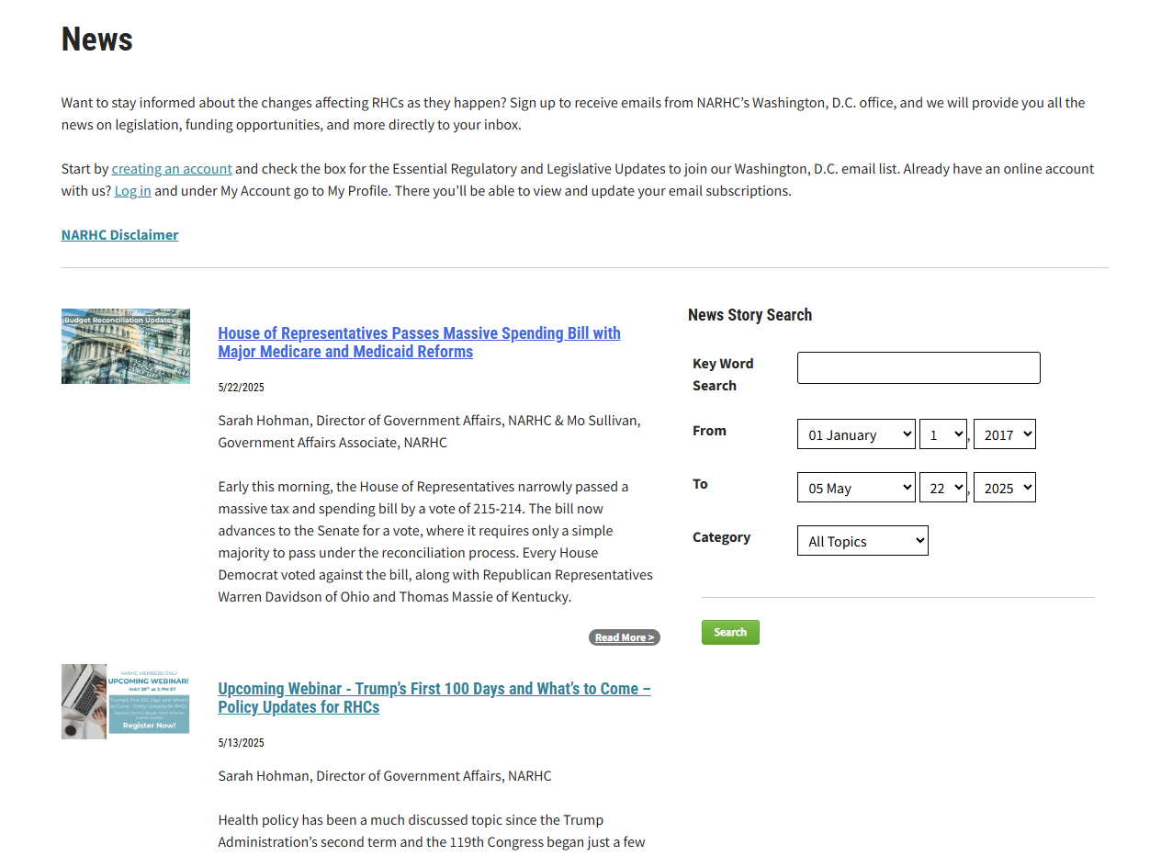
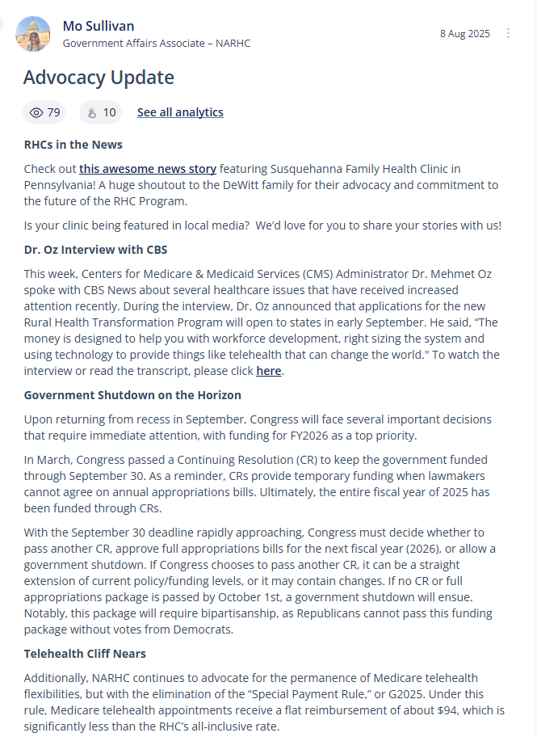
Stay “In the Know” on RHC Issues
NARHC.org
  Email Listserv
  Discussion Forum
    Weekly policy updates!
  NARHC News
  Resources
    TA Webinars
    Policy and Advocacy
State rural health organizations & offices of rural health
Federal Office of Rural Health Policy (FORHP) Weekly Updates
RHIhub
CMS RHC Center

Slide 21
Thank You and Questions!
Sarah Hohman, MPH, CRHCP
Director of Government Affairs
National Association of Rural Health Clinics (NARHC)
Sarah.Hohman@narhc.org

